Slide 1

#nextwaveoftech

Slide 2

Unit Economics

Slide 3
Depending on your business model / vertical you are tackling, there will be a number of different metrics important to your startup
Notes:
You may be monitoring your revenue, you may be monitoring your growth rate, awareness to acquisition conversion funnel, etc.
And you may also have heard of the Unit Economics, often a dreaded term and at times avoided as if it were a branch of the darks arts … which I have the luck of discussing with you today.
Hopefully we will demystifying the Unit Economics a bit better.

Slide 4
One thing ALL founders and investors have in common: the need to understand the viability of the business and signal when a course correction is in order!

Slide 5
Cash is King Burn Rate and Runway are priority #1
Notes:
You should at all times, be on top of your cash - how much do you have left, how much are you burning per month, when will you need to raise again.
As the cofounders, you should have these figures at your fingertips, at ALL times!!

Slide 6
Always!
Whether you are worth $500k or $2bn!
Notes:
This is true when you are starting out, but this will be equally as valid when you are worth billions!

Slide 7
Making Sense of Unit Economics
It can help answer the fundamental question, “Does this business model make sense?”
Notes:
Why do VCs keep going on about unit economics? Because they need to understand whether the business model you have in mind can actually ever make money on a fundamental level.
Is this ever going to become a viable business?
As you develop your business, your numbers will naturally improve (or at least that is the hope) - but it is important to understand the underlying mechanics of your model from the beginning to understand whether you can / will EVER make money.
You may think, “hello! Our existence is literally defined by us making money” – then what happened to all the startups that died in the past, a good number of them murdered by their own unit economics.
Surprisingly, a lot of businesses actually get this very, very wrong!! Here’s a case study that demonstrates JUST that!

Slide 8
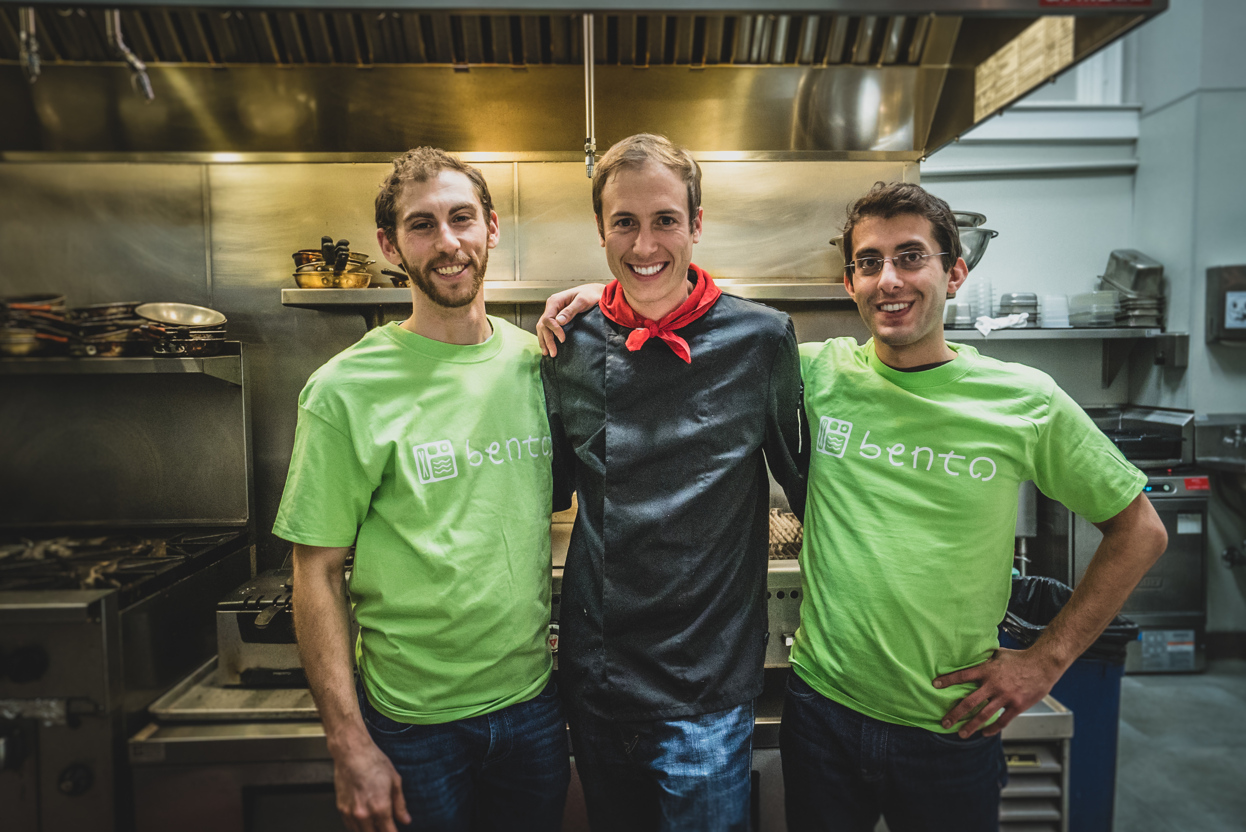
Notes:
This happy fellows are founders of Bento, an on-demand food-delivery app, born in San Francisco in 2015.
They met in 2014 on a website called Founders Dating.
Jason, the guy on the left, already had the idea. He was quite the visionary guy, who had left his corporate job a few months earlier, had travelled around Asia for a while, and now was ready to start his own venture. On the other side we have Vincent, much more pragmatic and more focused on the technology behind the app.
Their vision was to become a well-known brand like Chipotle but without physical restaurants. They would have drivers constantly moving around San Francisco, that would arrive to your house just a few minutes after your order. Sometimes just like magic.
And things went really well at the beginning.

Slide 9
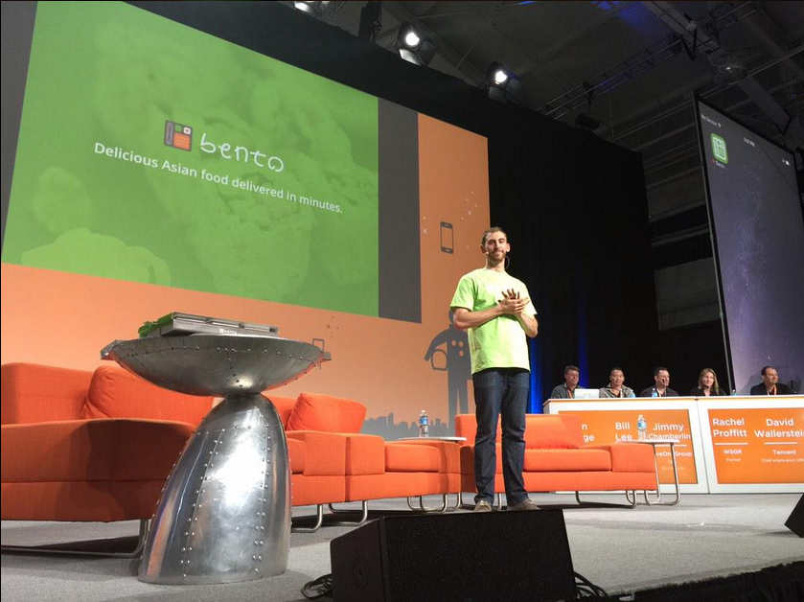

Notes:
They launched in March 2015. It was an event with an audience of 2000 people and they managed to secure a seed funding of 1.5 M just afterwards. Everyone was excited.
People talking to them were always asking questions like: how long will it take to you to arrive to LA? What’s your expansion plan?
It seemed that growth was equal to success. And Bento was definitely growing, very quickly.
3 months after their launch they added a head chef, an operations person and a new developer to work on their app. They even moved into a bigger kitchen. They were killing it.
Their crunch base profile even today says, “Since launch we have seen double-digit W/W growth”
And everything was perfect, until they received a monthly report from their accountant in late August.

Slide 10
“We burned almost $70,000 more than we expected — almost 30–40% more — and it was like ‘woah, what happened?’’’
Jason Demant, CEO of Bento
Notes:
They discovered that they had burnt almost 70 thousand dollars more than expected and Jason’s reaction was like: “Woah, what happened?” [-- a highly insightful observation. ]
Well, what happened had they been watching is quite clear

Slide 11
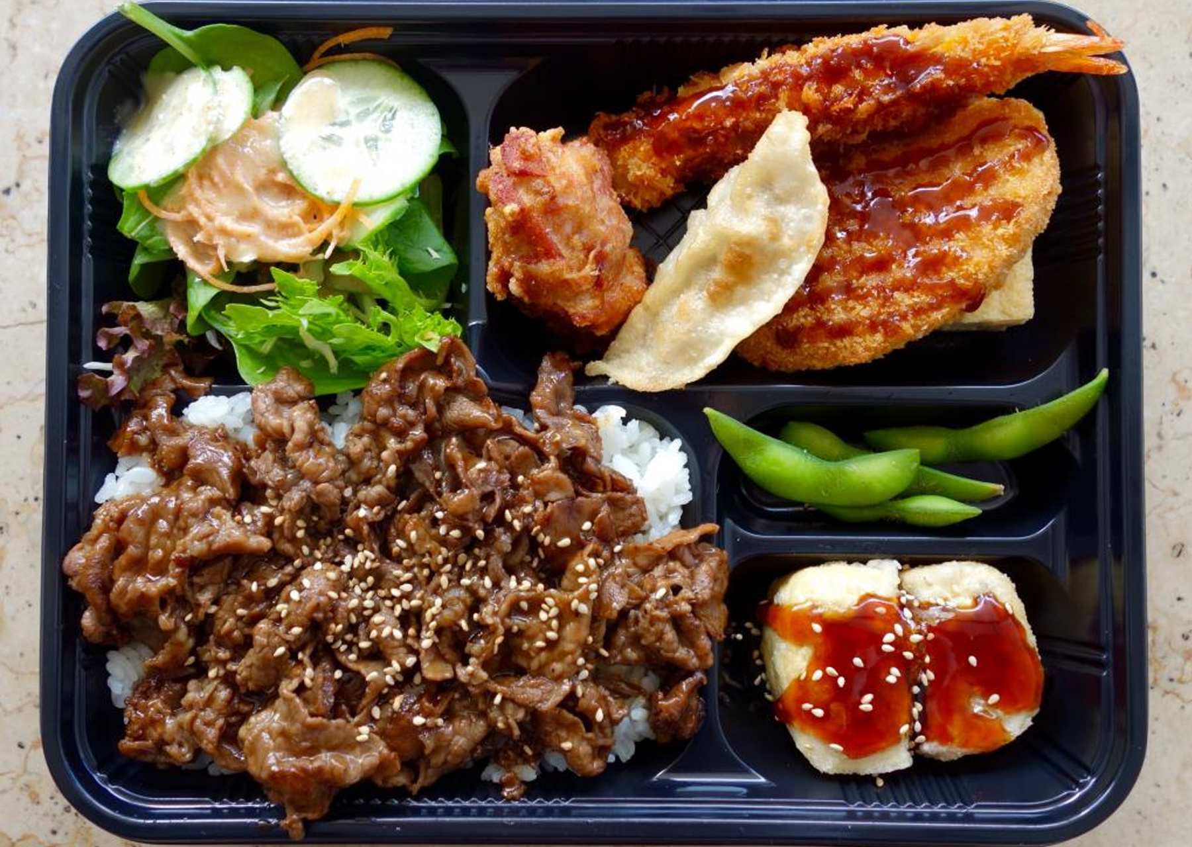


Margin (12.5%)
Other (7.5%)
Marketing (5%)
Delivery (15%)
Labour + Packaging (30%)
Ingredients (30%)
Source: estimates by Dealroom.com based on annual reports & interviews
Notes:
In a fully integrated food delivery business like the one they had there are many elements of cost.
· - You have the ingredients, which might be quite expensive, especially if we are speaking about wild caught salmon or rare meat as in the case of Bento
· - You have to pay the chef who’s cooking it and the beautifully designed packaging that’s an important component of the customer experience
· - You then have delivery, and costs go up if you want it to be very quick, because you need more drivers
· - And after having considered also marketing
· - And other costs
· - What’s left is finally a margin, which however will have to cover some other costs that are not directly associated to the product
Btw this cost breakdown is more the one of an established business. During the first few years your margin will probably be tinier.

Slide 12
Loss on each Bento box:
$20
Other (15%)
Marketing (25%)
Delivery (50%)
Labour + Packaging (35%)
Ingredients (40%)
Source: estimates by Dealroom.com based on annual reports & interviews
Costs total 160% of revenues
Notes:
The problem with Bento is that their situation was looking more like this.
Marketing was 5x
Delivery was 2.5x
Other was 2x
They were selling each box at 12 dollars, while the cost of making it was 32. So, they were losing 20 dollars on each box, which is bad. But what’s worse is that, before that report from their accountant, they had no clue about it.

Slide 13
“I mean, it’s almost a little embarrassing — because I should have been watching operation costs, especially in an operationally-intensive business like this”
Jason Demant, CEO of Bento
Notes:
At the beginning, Jason was quite embarrassed. And if we think about it, his main problem was probably much bigger than the losses they were making on each box sold.
Both him and Vincent were tech guys, and they basically started a restaurant with no knowledge at all about the restaurant industry. There were many details to manage: Jason spent most of his time hiring cooks, buying saucepans, dispatching drivers, ordering wild caught salmon, avocados and Asian pears.
He would have also needed to take inventory and make sure pricy ingredients weren’t going to waste. Lots of details and costs that he wasn’t tracking closely.
Since money in the bank account would keep them alive for just a couple of months, they needed to put in place some turnaround actions, and they needed to do it quickly.

Slide 14

Turnaround Actions
Both co-founders focused on financials
No more expensive ingredients
Longer delivery times + delivery fee
“Order Ahead” feature
Notes:
They decided to put in place 3 main solutions:
· First of all, both of them would have been focused on financials (also Vincent who was the CTO). Due to the emergency situation, this was not the best time to invest time thinking about app features and tech infrastructure
· The would have eliminated from the menu all dishes with expensive ingredients
· They would have allowed delivery times to be less ambitious, adding a delivery fee as well
For 3 days, it worked. Sometimes they were making a penny out of a box, sometimes 50cent, other times even a dollar of profit. They saw it as an accomplishment, but it didn’t last.
They found out that on-demand wasn’t making money, so they needed a better way to predict demand, to reduce waste.
· They solved it adding an “Order Ahead” feature
(every day, customers could tell in the morning which meal they wanted for lunch)
Well, from an internal perspective it’s perfect: every day you can just buy the ingredients you need and you basically have zero waste. Not sure about how much sense it makes for the client: before they could just order when hungry. Now they had to plan in advance, and also pay a fee for that.
As imaginable, sales drastically dropped down. For a while they thought about shutting down the app and basically transform themselves into a more traditional catering business. But actually, it wouldn’t make a lot of sense. They didn’t have much money left and it would have been difficult attracting investors now that they didn’t have good numbers to show them.

Slide 15
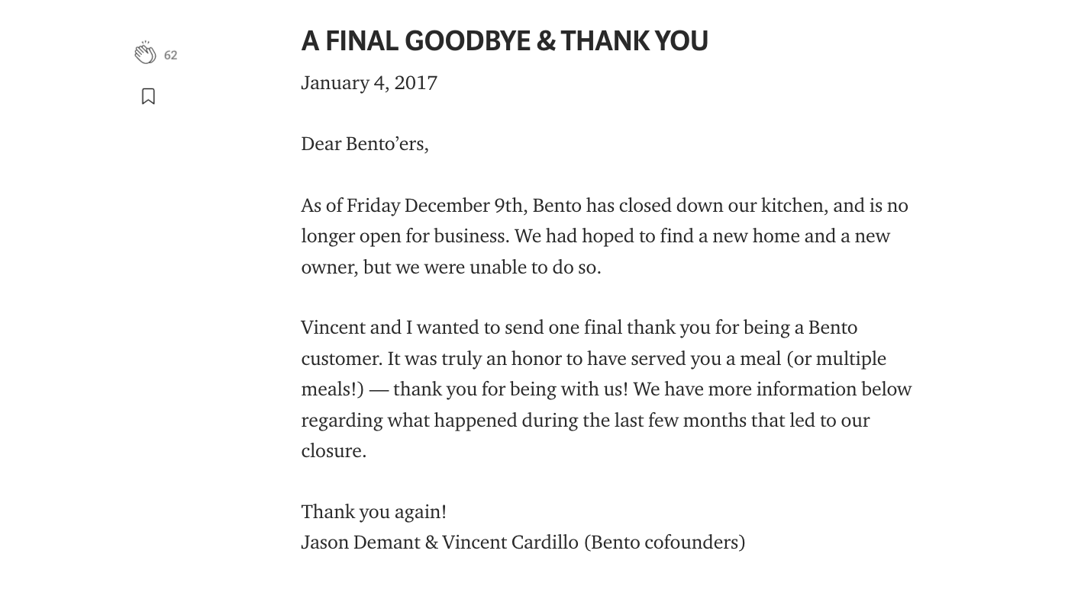
Notes:
So, at the end, Bento was shut down. And this a final goodbye that founders wrote for all their customers.
In the period in which Bento was founded, food delivery companies managed to attract a lot of investment. An app called Sprig secured 45M, another one, Munchery raised 85m. None of them exist anymore.
Those days of venture capital enthusiasm for food delivery are definitely over. Now investors are more conscious. They just don’t want to see growth, they want to see how you make money.
And if there is one way to show that you can make money, it’s definitely unit economics.

Slide 16
Why understand your unit economics?
To get investment
But more importantly… to survive
Notes:
So, unit economics is particularly important for 2 reasons:
· Investors will want to see it
· You want to survive (which should be the most important reason)

Slide 17
Unit economics explains how much money you can make on a unit basis before fixed costs
Notes:
But what is exactly unit economics?
Unit economics explains how much money you make on a unit basis.
It makes you understand whether you have or not have a margin on every product you sell, and for a very young startup it is much more important than the bottom line of your income statement because …
If you have positive margins, no-one will really care about your losses. Your loss just indicates that you just need to sell more units to cover your fixed costs
· If you have negative margins, instead, the situation is very different. You are basically making a loss on every unit you sell. The more you grow, the more you’ll destroy value. And this is what was happening with Bento.

Slide 18
A company is a viable investment if it has positive unit economics
Notes:
As a result, a company will be a viable investment if it has positive unit economics.

Slide 19
Understanding your unit economics will
help you focus on what needs your attention as you scale, to achieve your goals
Notes:
As a result, a company will be a viable investment if it has positive unit economics.

Slide 20
When do we need to have our Unit Economics?
Ideally, yesterday! You should have a starting point of where your unit economics stands today so that later you will know what to course correct, by how much to course correct, etc.
Notes:
As a result, a company will be a viable investment if it has positive unit economics.

Slide 21

“If you can’t measure it, you can’t improve it.”
Peter Drucker
Notes:
As a result, a company will be a viable investment if it has positive unit economics.
Peter Drucker is known as the man who invented modern business management. He wrote 39 books on the subject and is widely regarded as the greatest management thinker of all time.

Slide 22


When we consider “units”, there are two options
Unit
Product
Customer
Notes:
When we consider units, there are two alternatives: product & customer.
Customer is a unit is useful when you have recurring revenues: e.g. SaaS, ecommerce, subscriptions
Product is a unit is useful when you have a tangible product and not that many repeated purchases, e.g. a TV, a mountain bike, etc.
It’s sometimes easily evident as to which should be the unit. If you find in your case that it’s not obvious, don’t be alarmed.
Many of you will be looking at your customer as your unit, simply because you don’t have one product.

Slide 23

Unit
Product
Customer
Notes:
Let’s delve a little bit more in detail into a producst unit

Slide 24
Contribution Margin
= Price per Unit - Variable Costs per Unit
Relatively simple:
Product price x Units
$
Sales
A bit more nuanced:
What are they?
Variable
Costs
Units
Notes:
A metric we will want to monitor is the Contribution Margin, which is the difference between the price of a unit and the variable costs associated to it.
In this graph, we can see two lines, the upper one which represents sales and the lower one which represents variable costs. The Contribution Margin will be the red area in the middle.
So, this formula here is apparently very simple: you just have to take the price and subtract the variable costs. However, while the price is something that you have clearly defined, variable costs might be more of an issue.

Slide 25

Revenue Per Unit | 100%
COGS* | 40%
Direct Labour | 20%
Shipping Costs | 5%
Payment Processing Costs | 3%
Packaging Costs | 3%
Contribution Margin | 29%
Note: COGS only refers to non-fixed aspects of COGS
Notes:
If for example we are producing electric skateboards, this might be the breakdown of costs
Pay attention here to how the unit cost is communicated. Like Market Size is a $ amount of potential revenue over a year (not months ,not weeks … always over 1 year), unit economics is clearest when communicated in %s with respect to revenue obtained from the unit. i.e. 100% represent revenue, and form that you chip away variable costs. When you’re done, what’s left is your contribution margin.

Slide 26

Implied breakeven is in early Year 2
Fixed Costs*
($)
100,000
Price: $ 300
Fixed Costs: $ 50,000
Units sold Y1: 500
Growth:15%
75,000
50,000
25,000
Y1
Y2
Y3
Y4
Years
*Costs that aren’t attributable to the production or sales of the unit, including some variable costs
Notes:
Under the assumptions indicated on the right, the cost breakdown we have previously seen would enable us to break even in year 2, which makes it a very interesting investment

Slide 27
Revenue Per Unit | 100%
COGS* | 40%
Direct Labour | 20%
Shipping Costs | 5%
Payment Processing Costs | 3%
Packaging Costs | 3%
Contribution Margin | 29%
Note: COGS only refers to non-fixed aspects of COGS
Notes:
But are these all the unit related costs? Can you think about other ones?

Slide 28
Revenue Per Unit | 100%
COGS* | 40%
Direct Labour | 20%
Shipping Costs | 5%
Payment Processing Costs | 3%
Packaging Costs | 3%
Customer Service | 6%
Contribution Margin | 23%
Note: COGS only refers to non-fixed aspects of COGS

Slide 29
Revenue Per Unit | 100%
COGS* | 40%
Direct Labour | 20%
Shipping Costs | 5%
Payment Processing Costs | 3%
Packaging Costs | 3%
Customer Service | 6%
Returns | 3%
Contribution Margin | 20%
Note: COGS only refers to non-fixed aspects of COGS

Slide 30
Revenue Per Unit | 100%
COGS* | 40%
Direct Labour | 20%
Shipping Costs | 5%
Payment Processing Costs | 3%
Packaging Costs | 3%
Customer Service | 6%
Returns | 3%
Server Costs | 1%
Contribution Margin | 19%
Note: COGS only refers to non-fixed aspects of COGS
Notes:
This drops the contribution margin to 19% (from 29%)

Slide 31
Implied breakeven is now mid Year 6
Fixed Costs* ($)
100, 000
75, 000
50, 000
25, 000
Y1
Y2
Y3
Y4
Y5
Y6
Y7
Years
*Costs that aren’t attributable to the production or sales of the unit, including some variable costs
Notes:
As we see, if we consider also the new costs, the margin goes from 29% to 19%. The company will break-even in year 7, which definitely makes it a less attractive investment … and less attractive to be the startup founder for the next 7 years either. Much more cash will be burnt.

Slide 32
Variable Costs
“Small” variations can make a huge difference
Notes:
As a result, a company will be a viable investment if it has positive unit economics.

Slide 33
Unit
Product
Customer
Notes:
The customer as a unit is a slightly different beast ….

Slide 34
Typically these are variable costs that increase proportionally as your customers grow
LifeTime Value
(LTV)
Cost of Generating
Revenue
?
Notes:
In the case of the customer, there are two metrics at play: LTV and Cost of Generating Revenue
Life Time Value of a customer is: the sum of all payments the customer will make over a number of weeks, months, years of being the startup’s customer. Return customer behaviour can be contract bound (like a SaaS subscription) or behaviour based (like Starbucks/Java customers who need their daily coffee)
Cost of Generating Revenue: is the sum total of marketing costs incurred by the company to get the customer to try the product and make at least 1 payment.
Cost of Generating Revenue should not be confused with CAC which is about acquiring the customer (i.e. marketing and sales costs)

Slide 35
Cost of Generating Revenue
Ad Spend + Sales Team Salaries + Creative Costs +
Technical Costs + Publishing Costs + Management Time +
Raw Materials
The number of customers acquired
Notes:
List not exhaustive …
Your unit economics needs to be adjusted over time

Slide 36

Life Time Value: Cash-on-Cash
LTV
$
Payback
churn
Cost of
Generating
Revenue
Time

Slide 37
Cost of Generating
Revenue
LifeTime Value
(LTV)
Notes:
Unit economics are positive in the case when LTV is bigger than CAC

Slide 38


“It’s okay to lose lots of money upfront, but you do have to have a plan someday on how to make lots and lots of cash flow”
Sam Altman,
Chairman of Y Combinator

Slide 39
LifeTime Value
Average Purchase Value
Average Purchase Frequency
*
Notes:
LTV: How much does a customer spend with you on average over a reasonable period of time (up to 3 years for early stage ventures)
LTV: average revenue a single customer is predicted to generate over the duration of their account.

Slide 40

LifeTime Value
$5.90
Average Customer spend per visit

Slide 41

LifeTime Value
$5.90
4.2
Average Customer spend per visit
Purchase Frequency Rate (per week)

Slide 42

LifeTime Value
$5.90
4.2
$1 288.56
Average Customer spend per visit
Purchase Frequency Rate (per week)
Average customer value per year
Notes:
2

Slide 43

LifeTime Value
$5.90
4.2
$1 288.56
20 years
Average Customer spend per visit
Purchase Frequency Rate (per week)
Average customer value per year
Average customer's lifetime span

Slide 44

LifeTime Value
$25 272
$5.90
4.2
$1 288.56
20 years
Average Customer spend per visit
Purchase Frequency Rate (per week)
Average customer value per year
Average customer's lifetime span

Slide 45
Cost of Generating Revenue
The Cost of revenue generating activities
The number of customers acquired

Slide 46




-$ 1000
Search Ads
550
Clicks
200
Paying Customers
-$ 500
Website Ads
Cost per visitor: $2.73
= $1,500 / 550 visitors
Conversion rate: 36.4%
= 200 / 550
Customer Acquisition Cost (CAC): $7.5
= 2.73/ 36.4%
Notes:
Let’s do a quick example of how marketing cost, as part of CAC (customer acquisitio cost), which is a subset of cost of generating revenues, will be calculated. Customer acquisition cost is the cost of how much $ it takes you to get a customer through the “door” to pay the first time.
Example on how to calculate CAC using ecommerce store example.
$1000 on web search advertisement
$500 on online advertisement
This resulted in getting 550 clicks. But not everybody who ends up clicking ends up following through to become your paying customer.
Let’s say 200 out of the 550 went on to purchase from you, i..e your conversion rate is 40%.

Slide 47
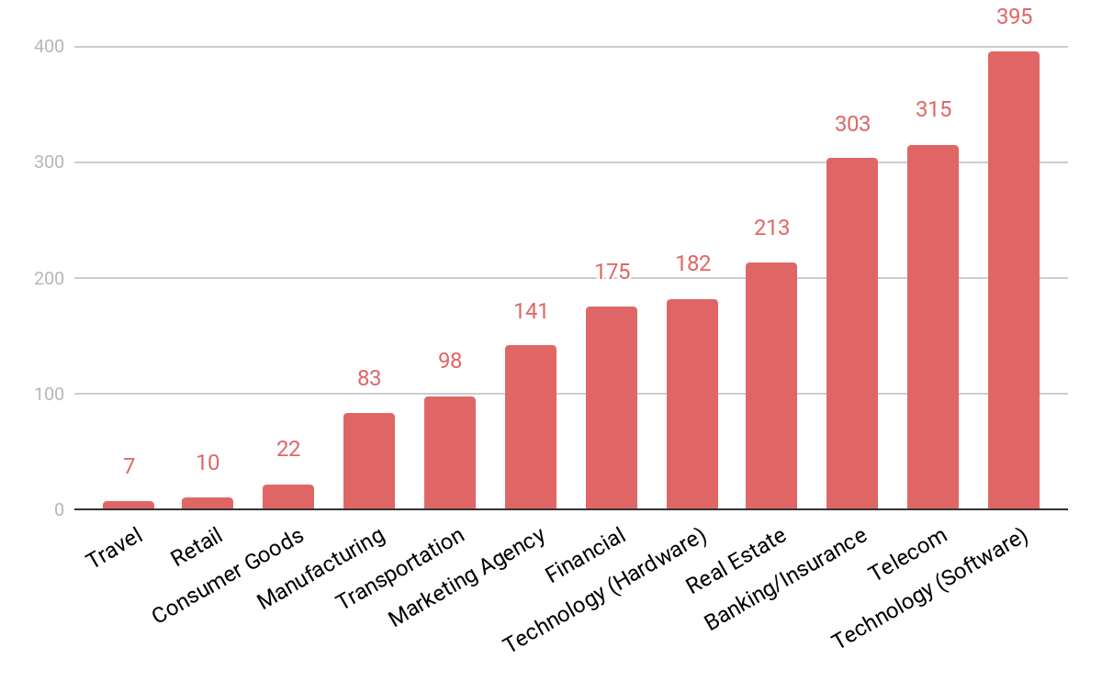
Customer Acquisition Cost
For Industries
Travel: $7 Consumer Goods: $22
Retail: $10 Marketing Agency: $141
Financial: $175 Technology (Hardware): $182
Manufacturing: $83 Transportation: $98
Real Estate: $213 Banking/Insurance: $303
Telecom: $315 Technology (Software): $395
https://www.demandjump.com/blog/customer-acquisition-cost-by-industry
Notes:
https://www.demandjump.com/blog/customer-acquisition-cost-by-industry
CAC for various industries. However outdated (2013 datasets)

Slide 48
Let’s do a quick exercise

Slide 49
1
The Unit
Identify your start-up's “unit”
The “unit” is the fundamental business measurement, and it will depend on the nature of the company or business operations. The unit can be the product, or the customer.
2
3
Price per Unit / Life Time Value
Identify Inflow Inputs
What are revenue streams?
What’s average revenue per stream?
What is the frequency revenue?
Over what duration will the revenue continue from one unit?
Cost of Generating Revenues:
Identify Outflow Inputs
What are direct unit costs (e.g. COGS)?
Marginal Operating Costs
Maintenance capex
Cost per acquisition, like marketing & slaes (CAC)
Cost of unit maintenance
Notes:
Worksheet: https://docs.google.com/spreadsheets/d/1pc2T7KpIuwNt6yi539XUcbwefSM_4xCk9nJwn4_xvOw/edit#gid=351319729
Objective: the aim is for the team to have a discussion about what is the “unit” – this is not always an easy question to identify, and specially difficult to comprehend why the customer is the right unit for sticky behaviour for some start-ups. The goal of this exercise is to get them to achieve any one of steps 1 – 4 during this exercise.
1)Per 1 above
2)Per 2 above
3)Per 3 above
4)Combine 3 & 2 to use actual $ values to create unit econ calculations
It should be perfectly acceptable for a team to have only discussed #1 during the 30 min breakout if that turns out to be an important question to clarify. Coaches should continue with a conversation during regular weekly sessions.
Other notes/reference:
A more detailed case study with discount rate considerations + LTV methodologies can be found here: https://blog.kissmetrics.com/wp-content/uploads/2011/08/calculating-ltv.pdf?_ga=2.90488605.649989771.1589055781-1697600589.1589055781
Antler VC metrics: https://drive.google.com/file/d/1FLlms5uoz2KVCkNOArwOCIzE5JfNHUKV/view?usp=sharing
https://www.cleverism.com/ultimate-guide-unit-economics/

Slide 50
00:30:00
Notes:
A more detailed case study with discount rate considerations + LTV methodologies can be found here: https://blog.kissmetrics.com/wp-content/uploads/2011/08/calculating-ltv.pdf?_ga=2.90488605.649989771.1589055781-1697600589.1589055781
Antler VC metrics: https://drive.google.com/file/d/1FLlms5uoz2KVCkNOArwOCIzE5JfNHUKV/view?usp=sharing
https://www.cleverism.com/ultimate-guide-unit-economics/

Slide 51
What can LTV/CAC tell you about your business?

Slide 52
Cost of Generating Revenue
Ad Spend + Sales Team Salaries + Creative Costs +
Technical Costs + Publishing Costs + Management Time +
Raw Materials
CAC
The number of customers acquired
Notes:
List not exhaustive …
Your unit economics needs to be adjusted over time. One major assumption by investors as well as by yourselves, for the health of the company is that, that your margins will increase over time, as your company becomes more efficient and your COGS reduce over time.
Especially for certain sectors, e.g. services and network orchestrator type businesses (ref Andreas), this leaves you with an interesting ratio that is the LTV/CAC.

Slide 53
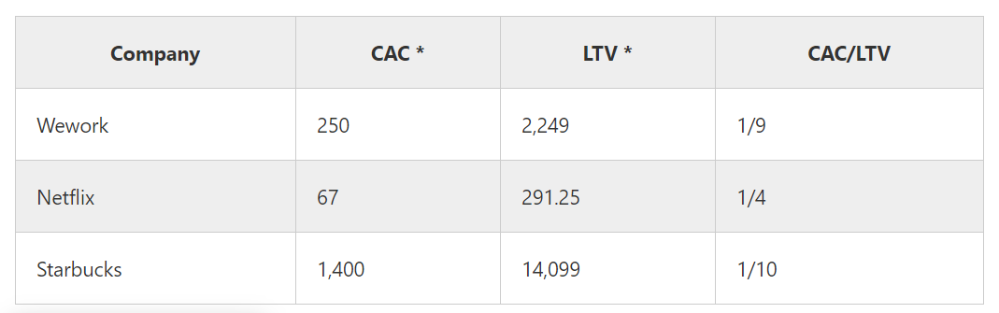
LTV/ CAC Examples of well-known companies
Especially the companies who grow exponentially during the last few years were keeping track of their unit economics. To give you an idea of different industries, products and business models, we researched for some of them.
( * Value in US $)
Source: Transactionwise
Notes:
Source: https://www.tractionwise.com/en/magazine/unit-economics/

Slide 54
Customer Acquisition Cost
For Industries
Travel: $7 Consumer Goods: $22
Retail: $10 Marketing Agency: $141
Financial: $175 Technology (Hardware): $182
Manufacturing: $83 Transportation: $98
Real Estate: $213 Banking/Insurance: $303
Telecom: $315 Technology (Software): $395
https://www.demandjump.com/blog/customer-acquisition-cost-by-industry
Notes:
https://www.demandjump.com/blog/customer-acquisition-cost-by-industry
CAC for various industries. However outdated (2013 datasets)

Slide 55
LTV:CAC
3:1
1:1
5:1
0 Profits
Underinvesting in marketing
Notes:
Healthy ration for most industries

Slide 56
It all DEPENDS
Notes:
It all depends on your industry, how valuable your customer is, how scalable your business model is etc

Slide 57
How to increase the ratio?
1:1
0 Profits
Underinvesting in marketing

Slide 58
Reduce CAC
Shorten sales cycle
Optimise your funnel
Lean approach to Marketing & Sales
Notes:
Ask audience
These are just suggestions

Slide 59
2. Increase LTV
Increase Loyalty: higher engagement, customer service etc
Make sure you bring value/solve a problem
Upsell or cross sell other products
Upgrade products
Depends on the business model
Notes:
Ask audience
These are just suggestions
Cross selling vs upselling

Slide 60
How to decrease the ratio?
0 Profits
Underinvesting in marketing

Slide 61
Increase CAC
(marketing expenses)
Notes:
However, don’t just throw money in marketing, but ensure that your marketing and sales strategy have more resources to be more effective and attract bigger audiences

Slide 62
What about economies of scale?
Notes:
To be fair, there are certain situations in which razor thin (or even negative) contribution margins might make sense.
Economies of scale: There are situations in which sales volumes make a material impact on your unit costs. An example would be in COGS, where retail businesses typically receive far more favorable terms from their suppliers at larger output levels.
However, with higher volumes other expenses increase such as storage rent, salaries etc. Moreover, it is difficult to objectively assess and predict the real impact of the economies of scale. Hence when it is within consideration, the unit economics could be negative but to a really small extent.

Slide 63

Key Messages
The boundary between fixed & variable /unit costs is often blurry:
When uncertain, better to consider costs as variable / unit driven
Consider absolute numbers not only %
The margin on product level should always be positive
If negative, be ready to explain why
It’s okay to burn cash initially if you know how to earn a lot later
It’s the story you tell investors; it’s the logic to your company’s survival

Slide 64
And most importantly
Know your cash!

Slide 65
“Every startup begins as an idea. And every idea needs a powerful story so that founders can win
the support of key audiences”
Keith Teare,
Executive Chairman, ADV
Notes:
Engagement: Q: what are the key audiences?
A: Customers and investors
Q: what kind of stories do we usualy tell customers?
A:
The customer. The story to a potential customer is all about what product or service you offer them, why they should care, how and when you plan to deliver it, and at what price.
The investor. The story to an investor is simply how the money they give you will grow into more value, how fast and how big. It is also why you and your team are best placed to execute on that.
Oftentimes, the customer story is solidified. However, the story founders tell investors, which should focus on what they get out of their investment, is typically underdeveloped. To fix that, you need to understand your startup’s unit of value, unit economics, scalability, and growth rate.

Slide 66
Useful resources:
LeanCase - software for forecasting and calculating
your unit economics
Template - spreadsheet template
Example - detailed example with calculations
LTV Formulas - business model specific formulas for LTV
Lifetime Span - formula to estimate if you don’t have historical data

Slide 67
